Slide 1

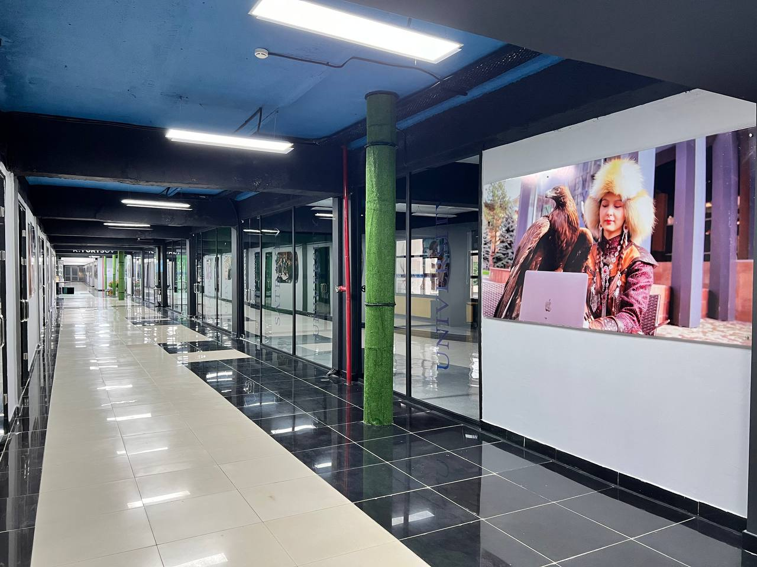
Department
"Information Systems"
Artificial intelligence—the foundation of intellectual information systems of the future!

Slide 2
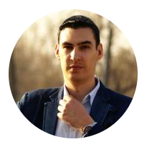







GUK 325
Serbin Vassiliy Valeryevich
Head of Department, Associate Professor, Candidate of Technical Sciences
v.serbin@satbayev.university

Slide 3
Mission of the Information Systems Department
The mission of the Information Systems Department at Satbayev University is to train a new generation of highly qualified specialists in the field of intelligent information systems and researchers in the field of design, development, and management of AI information systems capable of ensuring the digital transformation of the economy of the Republic of Kazakhstan and the international community.
The goal of the department is to create a modern educational and scientific environment that provides training for highly qualified specialists in the field of intelligent information systems, artificial intelligence, data engineering, and cloud technologies, capable of developing and implementing innovative AI digital solutions, conducting scientific research, and working effectively in the context of global digital transformation and sustainable development.

Slide 4
Objectives of the Department of Information Systems
Implementation of bachelor's, master's, and doctoral educational programs in the field of information systems design, development, and management.
Conducting research in the field of artificial intelligence (AI), Big Data, digital platforms, intelligent analytics, and business process automation.
Partnerships with IT companies and industrial enterprises to implement dual education, project training, and applied development.
Expanding academic mobility, participating in international projects, and developing English-language programs.
Formation of practical competencies, preparation for international professional certification, and assistance in finding employment for graduates.
Support for start-up initiatives, digital entrepreneurship, and the commercialization of scientific developments.

Slide 5
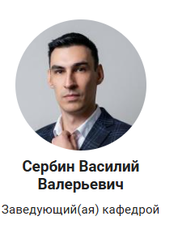
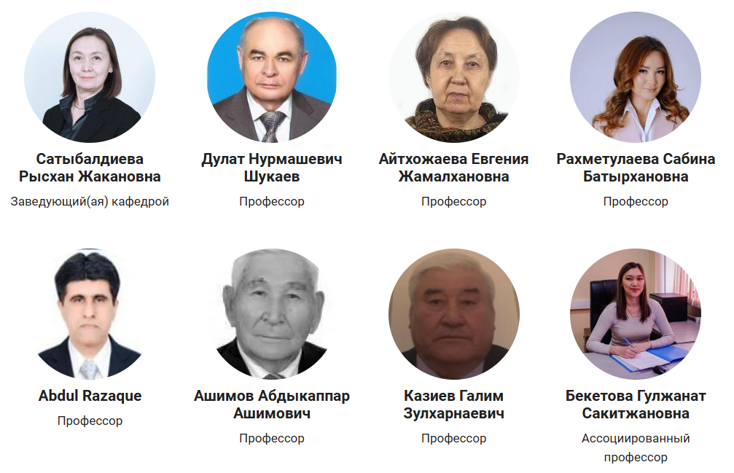

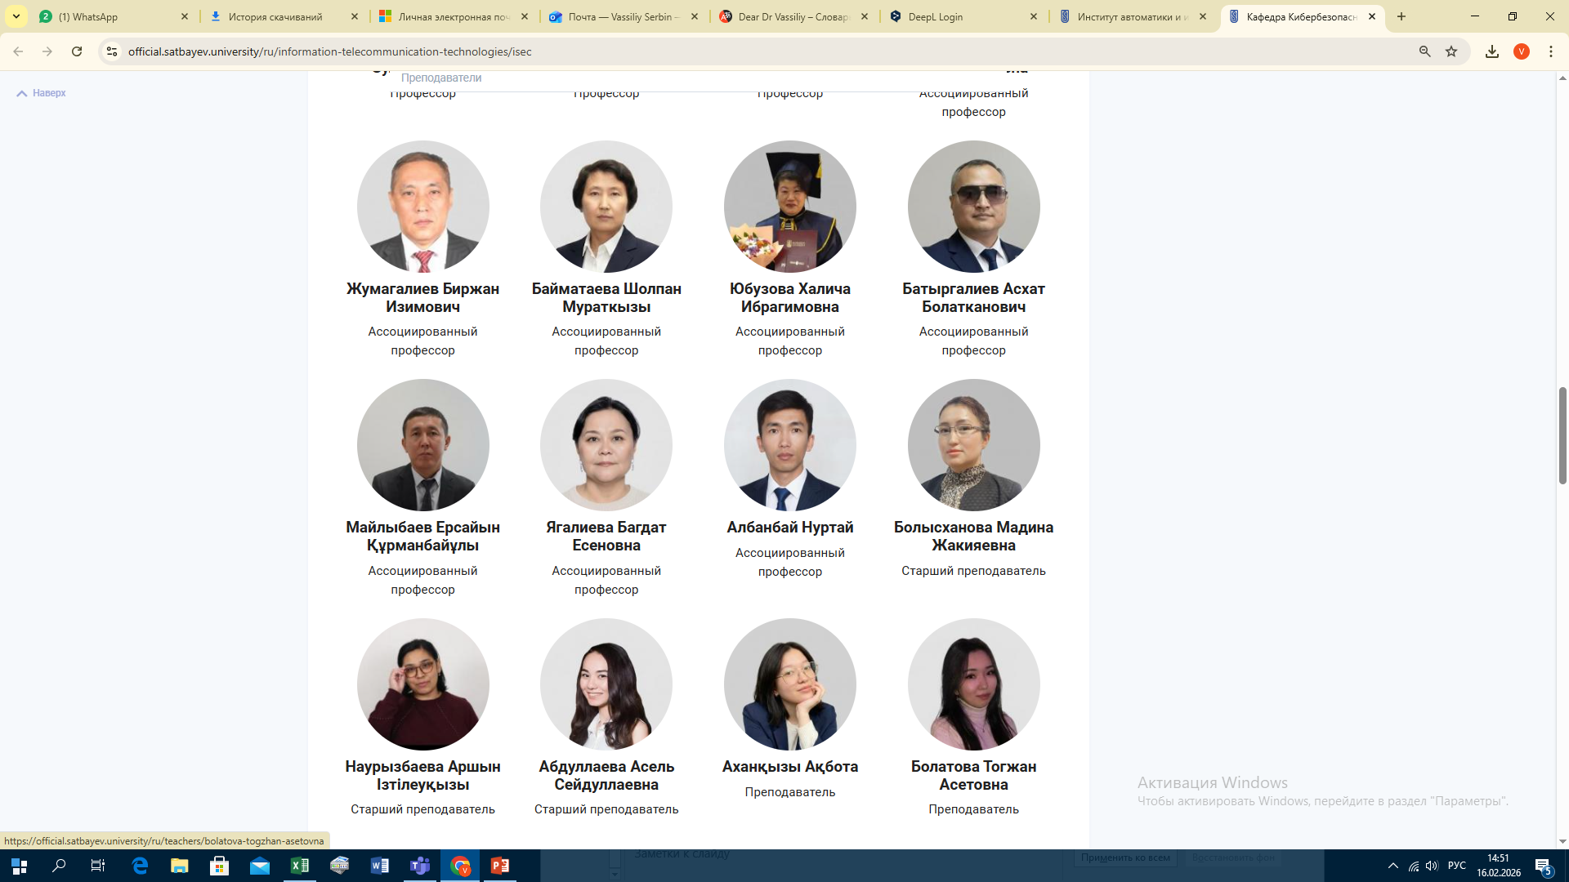
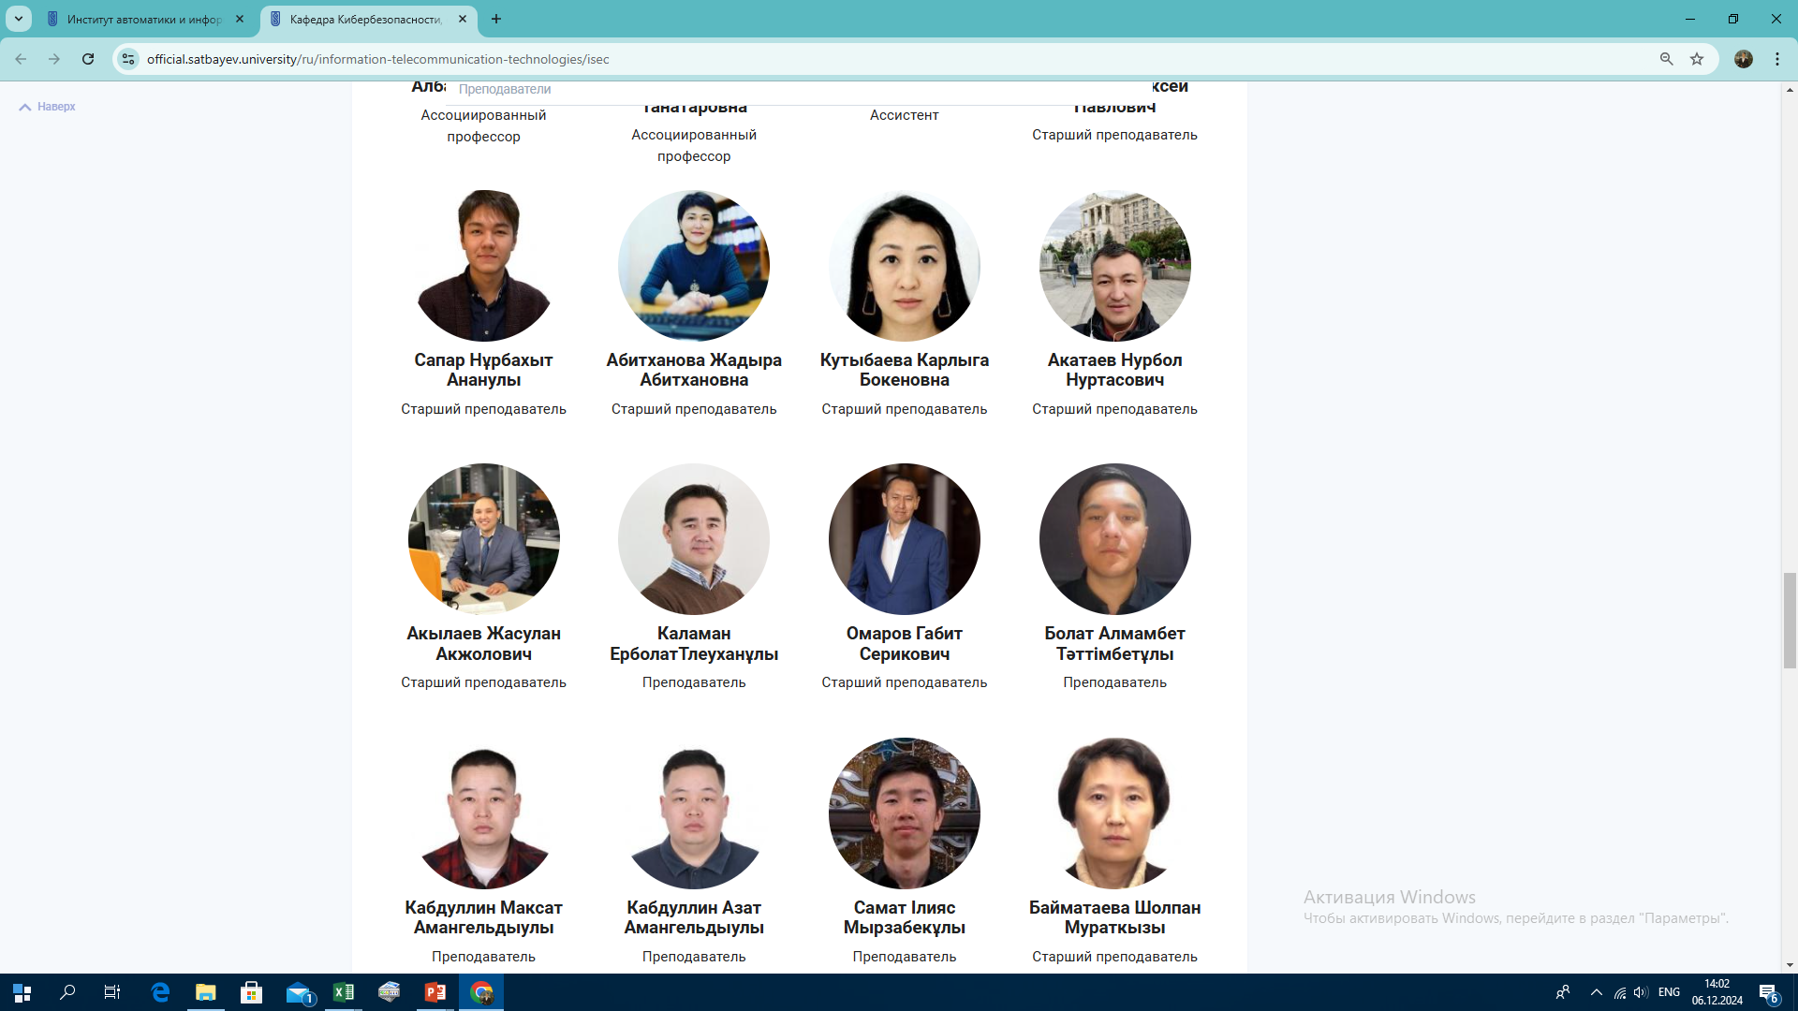

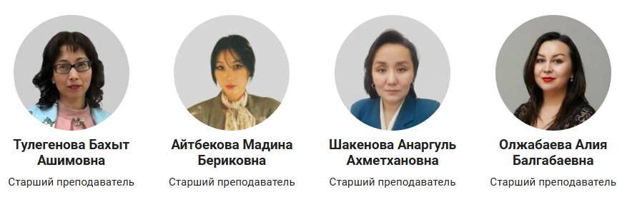
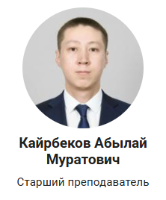
Faculty members of the IS Department
36%
Maturity
30
Staff

Slide 6
Current Student Enrollment (January 1, 2026)
Educational program | Total number of students
6B06106 – Information Systems | 851
7M06103 – Management of Information Systems (2) | 11
7M06108 – Management of Information Systems (1.5) | 18
7M06109 - Management of Information Systems (1) | 6
8D06103 - Management Information Systems | 8
TOTAL: | 894
95/4/1
Ratio of bachelor's/master's/PhD degrees

Slide 7



Fields of study
Accreditation
Educational programs:
Until 06.2031
Bachelor's degree
Information Systems (4 years)
Master's
Management of Information Systems (2 years)
Management Information Systems (3 years)
PhD
Management of Information Systems (1.5 years)
Management of Information Systems (1 year)
Until 05.2026
Until 05.2031
Until 05.2031
Until 06.2026

Slide 8
Educational program trajectories (bachelor's degree)
Information systems
DevOps
Business analytics and IT project management
IS Architecture
Business Application Development

Slide 9
IS trajectory disciplines:
DevOps
- DevOps engineering
- Design Patterns
- Startups and tech entrepreneurship
- Virtualization and containerization systems
- System design
- Database and web service development
- AI and machine learning
Business analytics and IT project management
- Data visualization and reporting
- Business process analysis
- Business process modeling
- Business modeling
- Business process automation
- IT project management
IS architecture
- Information systems architecture
- Continuous integration and deployment CI/CD
- IT audit and control
- Digital transformation technologies
- IS integration
- AI and machine learning
Business application development (1C, SAP)
- IS prototype development
- IS development for trade automation
- IS development for financial accounting
- Query language and report development

Slide 10
New disciplines in OP IS
Artificial Intelligence Module
1. Fundamentals of Artificial Intelligence
This discipline covers the basic concepts, methods, and technologies in the field of artificial intelligence: machine learning, computer vision, natural language processing, etc. Contents: general definition of artificial intelligence, intelligent agents, information retrieval and state space exploration, logical agents, artificial intelligence system architecture, expert systems, observation-based learning, statistical learning methods, probabilistic processing of linguistic information, semantic models, natural language processing systems.
2. Artificial Intelligence and Machine Learning
This discipline is devoted to the application of ML methods in various fields, such as computer vision, natural language processing, recommendation systems, medicine, and finance. The course is an introduction to the basic concepts, methods, and applications of artificial intelligence (AI) and machine learning (ML). During the course, students learn about various ML algorithms, such as linear regression, support vector machines, decision trees, neural networks, and data clustering. They also learn about data-driven learning theory, data preprocessing methods, model evaluation, and optimization techniques. The course includes both theoretical foundations and practical assignments, including working with real data and ML tools such as TensorFlow, scikit-learn, and PyTorch.
3. Generative AI and Intelligent Digital Assistants
This discipline is devoted to generative artificial intelligence technologies and their application in information systems. Students study large language models (LLMs), transformer architecture, prompt engineering, fine-tuning, retrieval-augmented generation (RAG), and the development of corporate chatbots and intelligent assistants. It addresses issues of security, data protection, ethics, and trust in AI, as well as the implementation of GenAI in ERP, CRM, and educational platforms. The practical part includes the development of a prototype intelligent assistant for business process automation or IS user support.
4. Intelligent Information Systems AI
This discipline aims to give students a systematic understanding of machine learning methods and their integration into corporate information systems. It covers supervised and unsupervised learning, classification and regression methods, neural networks, ensemble methods, feature engineering, model quality assessment, and AI interpretability. Particular attention is paid to the design of the architecture of intelligent modules within IS, working with big data, integrating ML services via API, and building prototypes on modern frameworks. As part of the course, students implement an applied project on the introduction of an ML module into the business process of an organization.

Slide 11
1,312,942,373
Funding for scientific activities
TOTAL:
tenge
IRN | Project name | Full name of scientific supervisor | Priority | Type of research | Competition | Implementation period | Amount of funding
AP19675961 | Development and research of key distribution protocols based on quantum properties | Begimbayeva Enlik Erikovna | Information, communication, and space technologies | Applied | GF 2023-2025 | 2023-2025 | 99,288,413
AP2348999 | Development of intelligent technology and a digital platform for adaptive zoning of territories in conditions of climate dynamics | Yagalieva Bagdat Esenovna | Advanced manufacturing, digital and space technologies | Applied | GF 2024 - 2026 | 2024 - 2026 | 90,000,000
AP23487678 | Development of a broadband, energy-efficient, and compact converter of mechanical vibrations in the environment into electrical signals | Albanbay Nurtai | Advanced manufacturing, digital and space technologies | Applied | GF 2024–2026 | 2024–2026 | 119,758,000
AP19678995 | Development of a method for speaker recognition using deep neural networks with ultra-short duration of clean speech | Akhmediyarova A.T. | National security and defense | Applied | GF 2023 - 2025 | 2023 - 2025 | 90 234 130
BR24993166 | Development of a comprehensive innovative online platform, an automated legal assistance system, and a unified system for automating the work of lawyers | Akhmediyarova A.T. | Intellectual potential of the country | Applied | PCF 2024-2026 | 2024–2026 | 855,000,000
AP22686112 | Study of somatic mutations based on single-cell RNA data using machine learning methods in patients with peripheral artery disease | Kunikheev A. | Advanced manufacturing, digital and space technologies | Applied - Bioinformatics | Zhas-Galym 2024–2026 | 2024 - 2026 | 29,816,820
AP24786145 | Development of an algorithm for filtering and preprocessing biomedical images for cardiological diagnostics | Kabdullin Maksat | Advanced manufacturing, digital and space technologies | Applied - Bioinformatics | Zhas-Galym 2025–2027 | 2025–2027 | 28,845,010

Slide 12




GF Project 2022-2025: Intelligent Credit System
for manufacturers/importers of goods
Head:
Moldagulova A.N., Ph.D., Professor
Scientific novelty
Test sets with real and synthetic data (revenue, profit, liquidity ratio, debt burden, credit history, industry risk, duration of existence, type of activity, reputation rating, default fact) have been created. The model has been tested on real SME samples — ~94% match with expert conclusions in pilot scenarios.
Hybrid approach: combining ontologies, rules, and ensemble/neural network models for PD/LGD/EAD with Explainable AI; adaptation to RC specifications and integration with national registries.
Pilot results
Reduction of application analysis time from 10–15 minutes to ~1–2 minutes; increased objectivity of decisions; resistance to incomplete data thanks to meta-knowledge and backup mode rules.
Quality metrics
AUC ≈ 0.63–0.64, average analysis time ~2 seconds (modular test), stability on anonymized partner transactions.

Slide 13
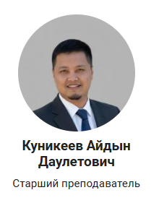
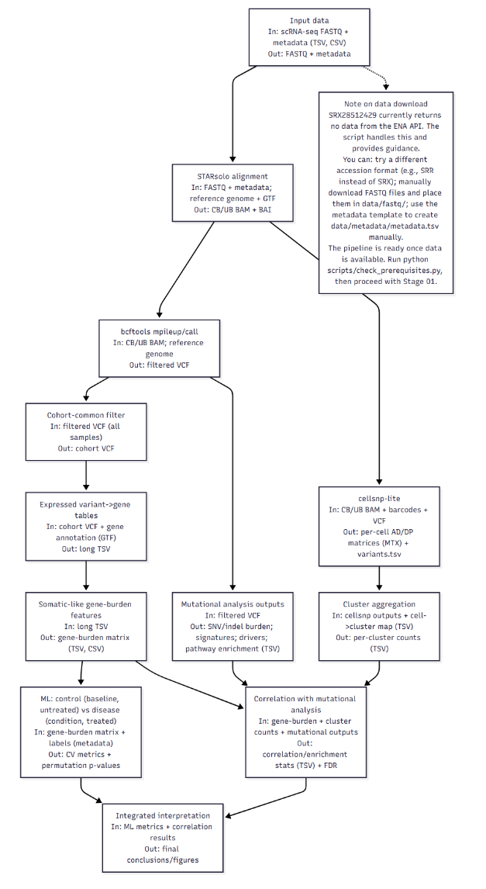
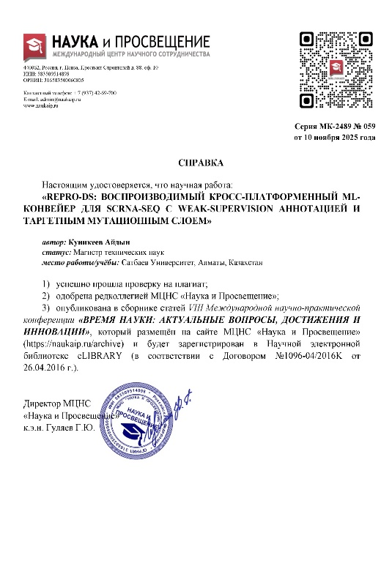
Jaz-Galym Project 2024-2026: Investigation of somatic mutations based on single-cell RNA data using machine learning methods in patients with peripheral artery disease
Interim results of the project:
Systematization of genetic data clustering methods
Analysis of the characteristics of scRNA-seq data processing
Identification of key problems in genetic data analysis
Analysis of current trends and prospects
Formulation of generalized recommendations
Scientific novelty
The main novelty of the project lies in the comprehensive integration of modern cluster analysis methods, taking into account the specifics of high-dimensional gene expression data, especially single-cell RNA sequencing (scRNA-seq) data, and the formation of a systematic approach to their processing and interpretation.
Final project outcome
The main result is a comprehensive systematization of modern methods for processing and clustering genetic data, identification of their advantages and limitations, and determination of promising directions for the development of data analysis in genomics.

Slide 14
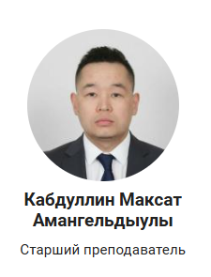
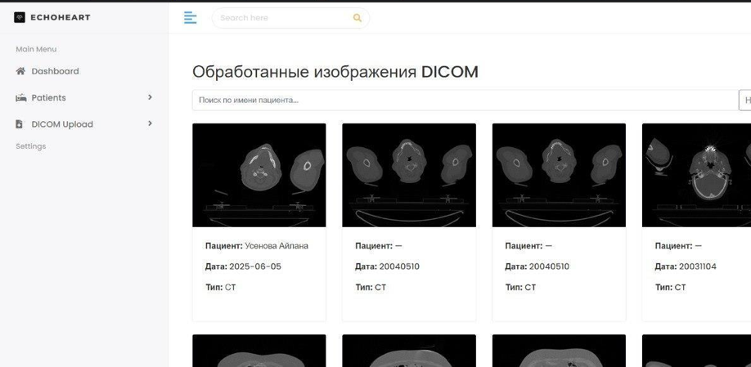
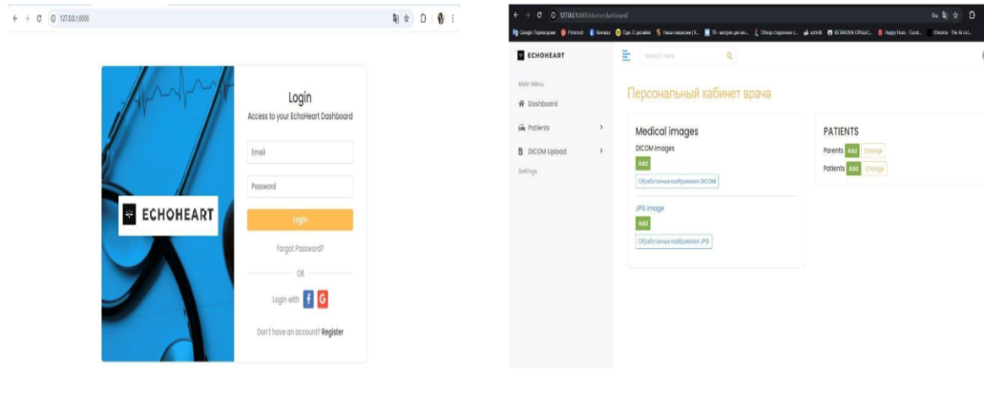
Jaz-Galym Project 2025-2027: Development of an algorithm for filtering and preprocessing biomedical images for cardiological diagnostics
Current results:
Analysis of existing biomedical image processing methods
A prototype filtering algorithm has been developed and implemented
Initial testing on cardiological images has been conducted
Scientific publications on the research topic have been prepared (2 KKSON published + Q3 in the process of submission)
An agreement on scientific and practical cooperation has been concluded with the Hospital of the Medical Center of the Presidential Administration of the Republic of Kazakhstan (Almaty)
Next steps
• Optimization of algorithm parameters
• Expansion of the test sample
• Conducting a quantitative assessment of processing quality
• Preparation of the final version of the algorithm

Slide 15
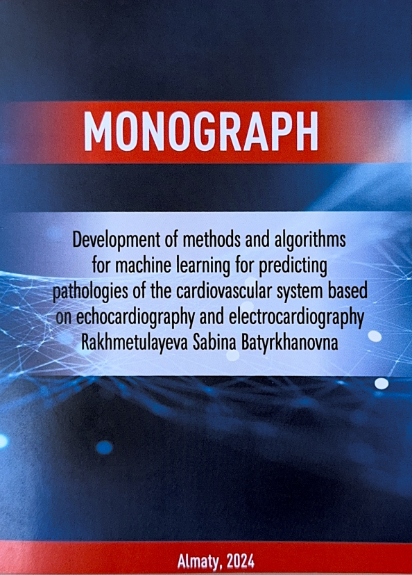
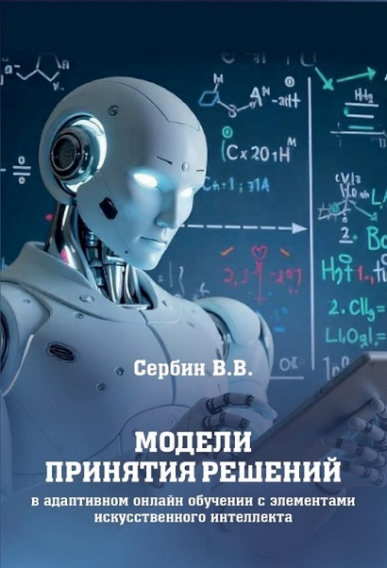
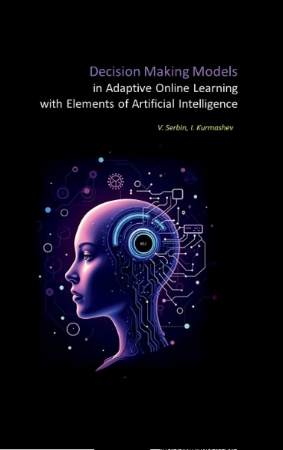
Monographs related to AI
Rakhmetulaeva S.B., PhD, Professor
Serbin V.V., PhD, Associate Professor
Serbin V.V., Ph.D., Associate Professor

Slide 16
Percentage of faculty members with a Hirsch index
No | Full name of faculty member | h-index (Scopus)
1 | Ashimov A.A. | 9
2 | Kozhamzharova D.Kh. | 8
3 | Rakhmetualayeva S.B. | 5
4 | Modagulova A.N. | 4
5 | Satybaldiyeva R.Zh. | 4
6 | Serbin V.V. | 3
7 | Shukaev D.N. | 2
8 | Baimtyaeva Sh. | 2
9 | Zhumagaliyev B.I. | 1
10 | Aristombaeva M. | 1
11 | Bolyskhanova M.Zh. | 1
12 | Tulegnova B.A. | 1
Full-time faculty members
48%=
12
25

Slide 17
Dynamics of scientific works
Monographs (2024-2025 academic years):
Patents (2023-2025):
Serbin V.V. -1
Rakhmetulaeva S.B. -1

Slide 18
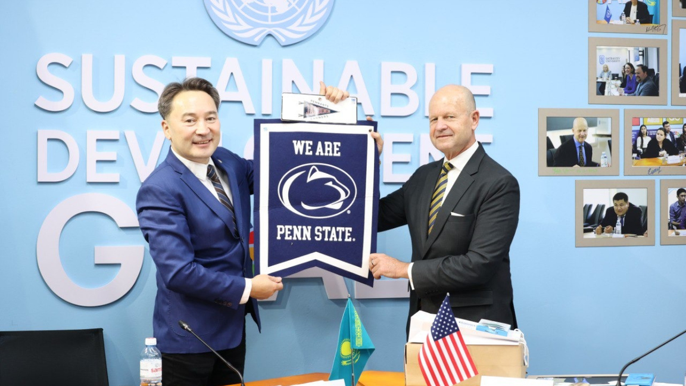
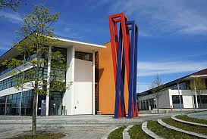



Dual degree programs and joint educational programs
SU educational program | Partner University Educational Program | Double degree/ Joint | Number of students | Status
6B0106 – Information Systems | Computer Science | Joint | 12
7M06103 – Management of Information Systems | Inha University | Double degree 3+1 |  | In terms of

Slide 19
Percentage of foreign students
2.35
No | Code and name of educational program | Number of students
2 | 6B06106 Information Systems | 15
3 | 7M06109 Management of information systems | 6
 | TOTAL: | 21
Contingent of the IS department as of January 1, 2026.
Total: 894 people

Slide 20
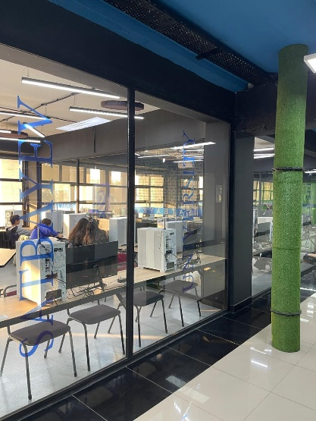
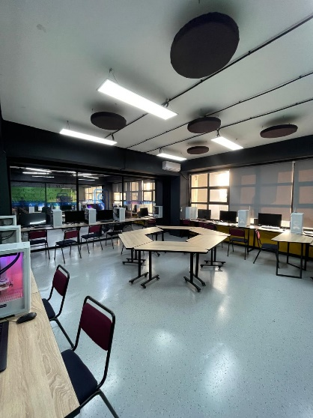



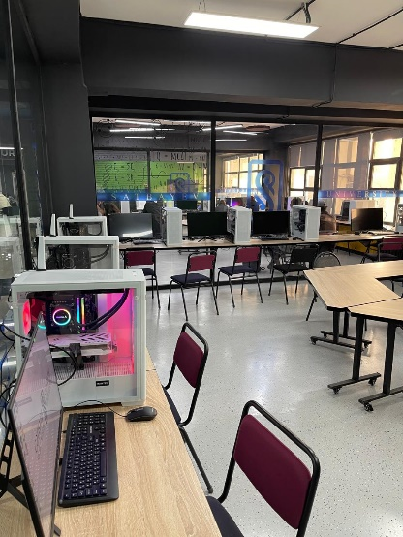
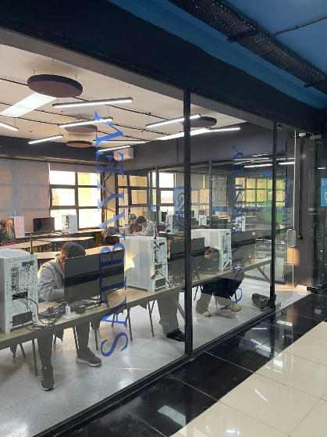


Department laboratories
Cisco Laboratory
HUAWEI Laboratory
1C Laboratory
MyBPM Laboratory for Business Process Automation

Slide 21
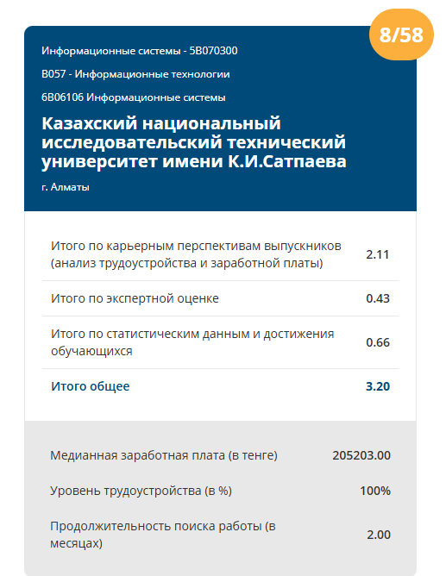
Percentage of graduates employed in the first year after graduation out of the total number of graduates
100%
Source: www.atameken.kz

Slide 22







Communication with employers

Slide 23



SOCIAL NETWORKS Satbayev University
Website
Youtube
VK
Facebook
Instagram
TikTok
Telegram

